Slide 1
Construction of Emergency Shelter in Louisiana
Jorsh Construction Inc.
Hanny Khairy, Jose Hungria-Negron, Omotolani Adelekan, Ryan Sarco, Suzana Dias de Souza

Slide 2
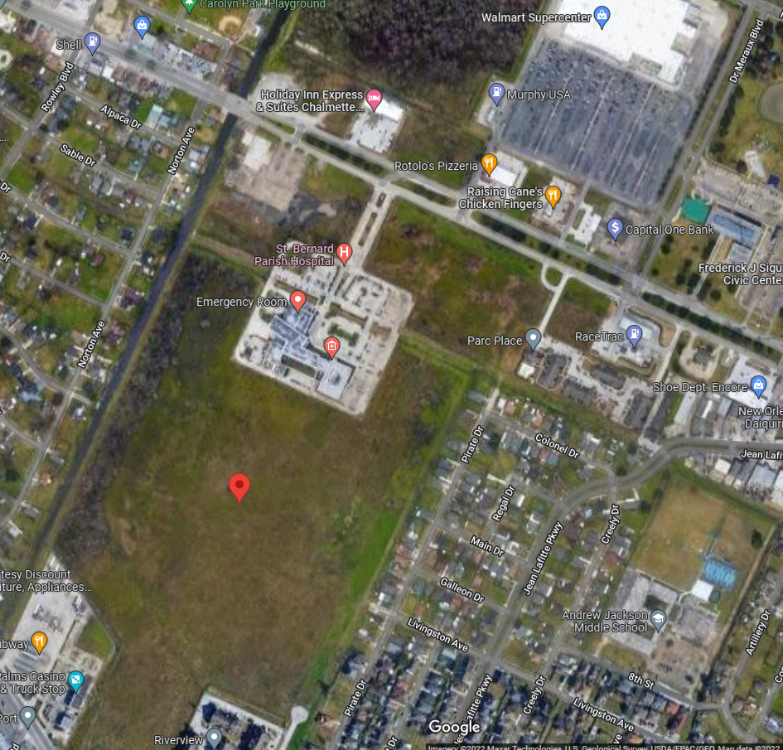
Introduction
Emergency shelters are necessary to secure the safety of people who are in danger of a natural disaster hitting their houses
Hurricane Katrina was a category 5 Atlantic hurricane going at about 280 km per hour, killed over 1800 people, destroyed 800,000 homes, and total damages of around $160 billion
Our team at JORSH construction INC. plans to build an emergency shelter for the people who reside in New Orleans, St. Bernard Parish since it was severely flooded.
We want to construct a strongly elevated shelter that can withstand the next possible natural disaster
The plan is to construct the shelter at 29.952382, -89.989983. It’s a large field that’s next to a hospital for anyone who sustained any injuries and a Walmart for supplies.

Slide 3
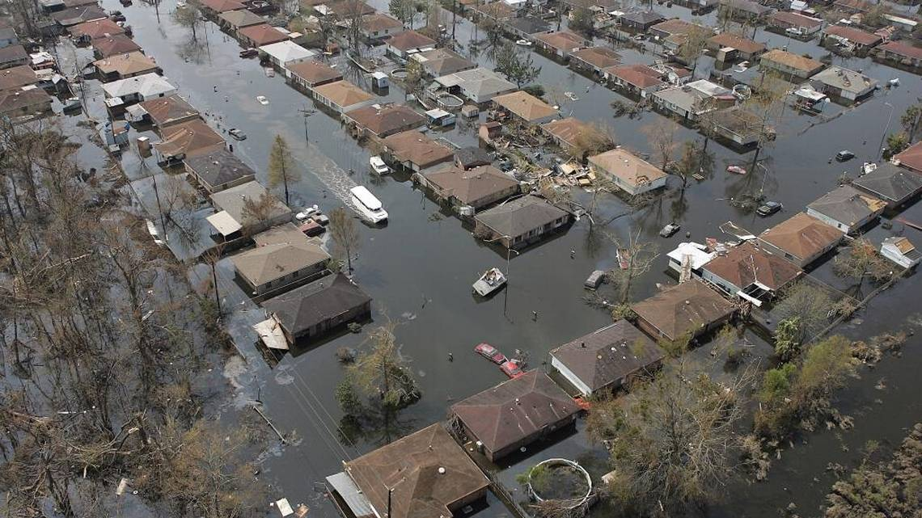
1.1 Problem Statement
When hurricane Katrina hit, St. Bernard Parish was in ruins
A total of 8,300 homes were destroyed, about 68,000 people were left homeless, and 164 people were killed because of the flooding
This left thousands of people stranded and lost with no shelter
Another concern was that it will take years for St. Bernard Parish to recover from hurricane Katrina
The idea of an emergency shelter will help those struggling to find a temporary home. It will also provide the supplies and food needed to help them survive the disasters that ensued.

Slide 4
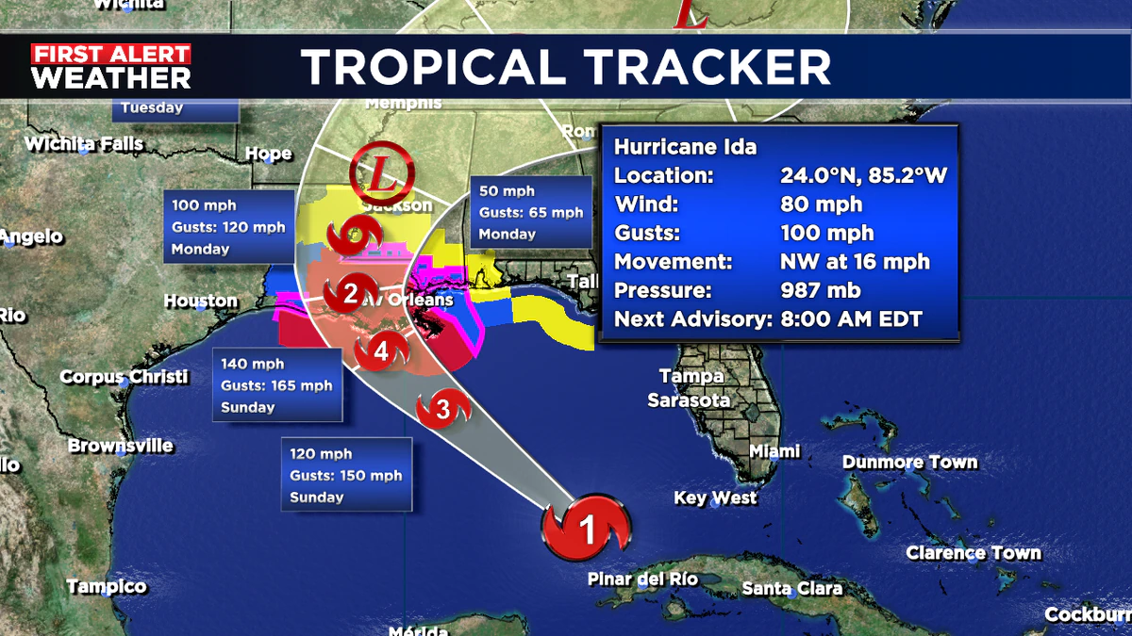
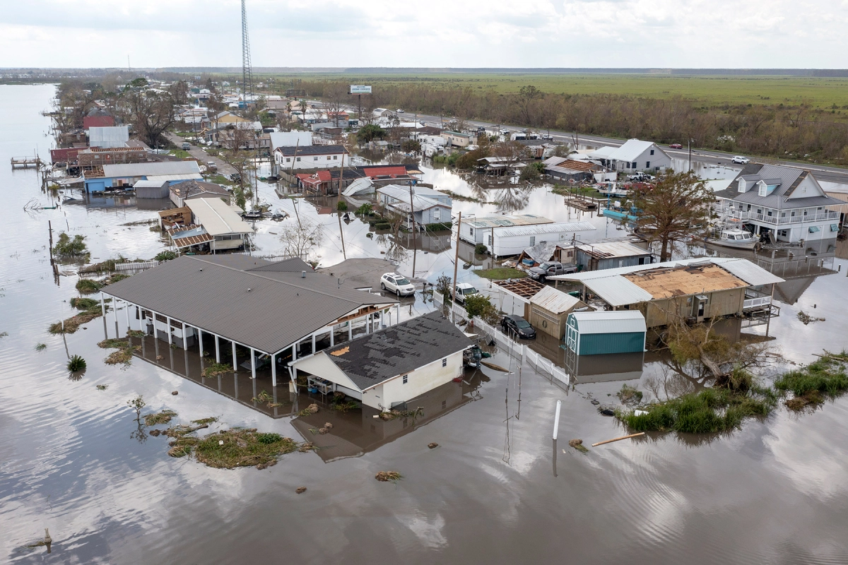
1.2 Background Information
The state of Louisiana is surrounded by large bodies of water and therefore at risk of receiving the initial impacts of a hurricane.
Looking at Louisiana’s geography, it is located by the Mississippi River, above the Gulf of Mexico, and has relatively flat land.
Problems: Flooding and strong destructive winds
Solution: Building a structure strong enough to resist these natural forces and provide shelters for those in need.
Notes:
https://www.rollingstone.com/culture/culture-news/hurricane-ida-louisiana-mutual-aid-help-1219847/
https://www.mysuncoast.com/2021/08/28/2-am-update-hurricane-ida-track-louisiana/

Slide 5
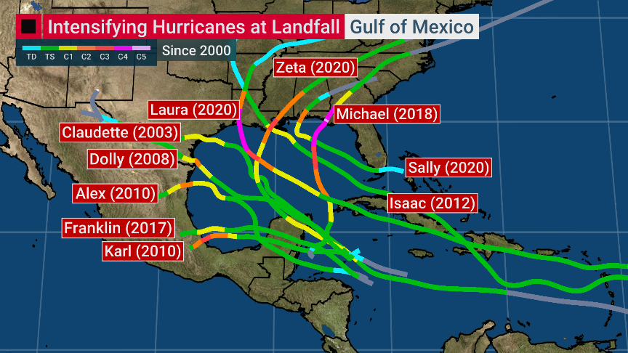
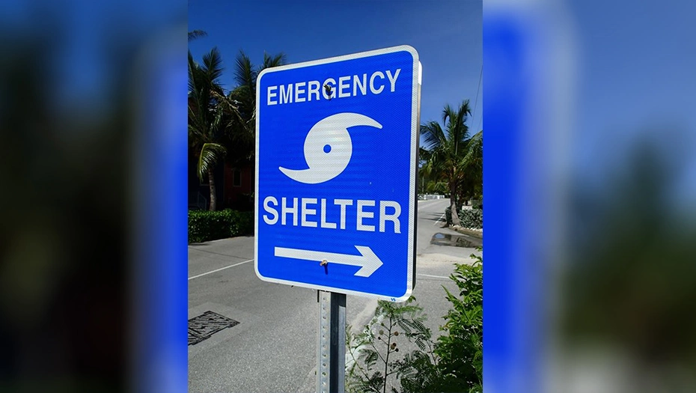
1.3 Needs Statement
Louisiana is a hurricane-prone state in a world where climate change is becoming more threatening through intensified storms, sea level rises, and floods.
Hurricanes are able to cause a lot of destruction and leave people without homes or resources to survive.
A safe haven must be provided for citizens during hurricanes as well as resources for the immediate aftermath.
Notes:
https://www.arklatexhomepage.com/news/state-news/louisiana/louisiana-emergency-shelter-locations-for-hurricane-ida/
https://twitter.com/DrRickKnabb/status/1430682183174397955

Slide 6
1.4 Objective
Our objective is to establish a safe haven for Louisianans under the threat of severe weather events. In an event such as a hurricane, people tend to go missing if they have not found safety in a structure that is able to withstand its impacts. If people go missing, this creates panic and fear for friends and families alike. Therefore, one of our objectives is to eliminate this fear and assure residents that they will be safe without worry.

Slide 7
2. Proposed Technical Approach
JORSH Construction Inc comprises of:
An Environmental engineer responsible for surveying the location to ensure that the soil is suitable for the shelter
An Architect responsible for creating the design of the shelter by using the AutoCAD software
A Structural engineer responsible for designing the structural supports system for the shelter
Two Civil engineers responsible for supervising and overseeing the construction of the shelter.
JORSH construction intends to hire an electrical engineer and other needed personnel

Slide 8
2.1 Requirements
For our personnel requirements we will need the following:
Civil, Environmental, Mechanical, and Project Engineering team as well as an Electrical engineering team
Architect to create floor plan to map out the different measurements of the building
Other Requirements
Materials
Transportation (allow to move the materials that are needed to construct/build the shelter)

Slide 9
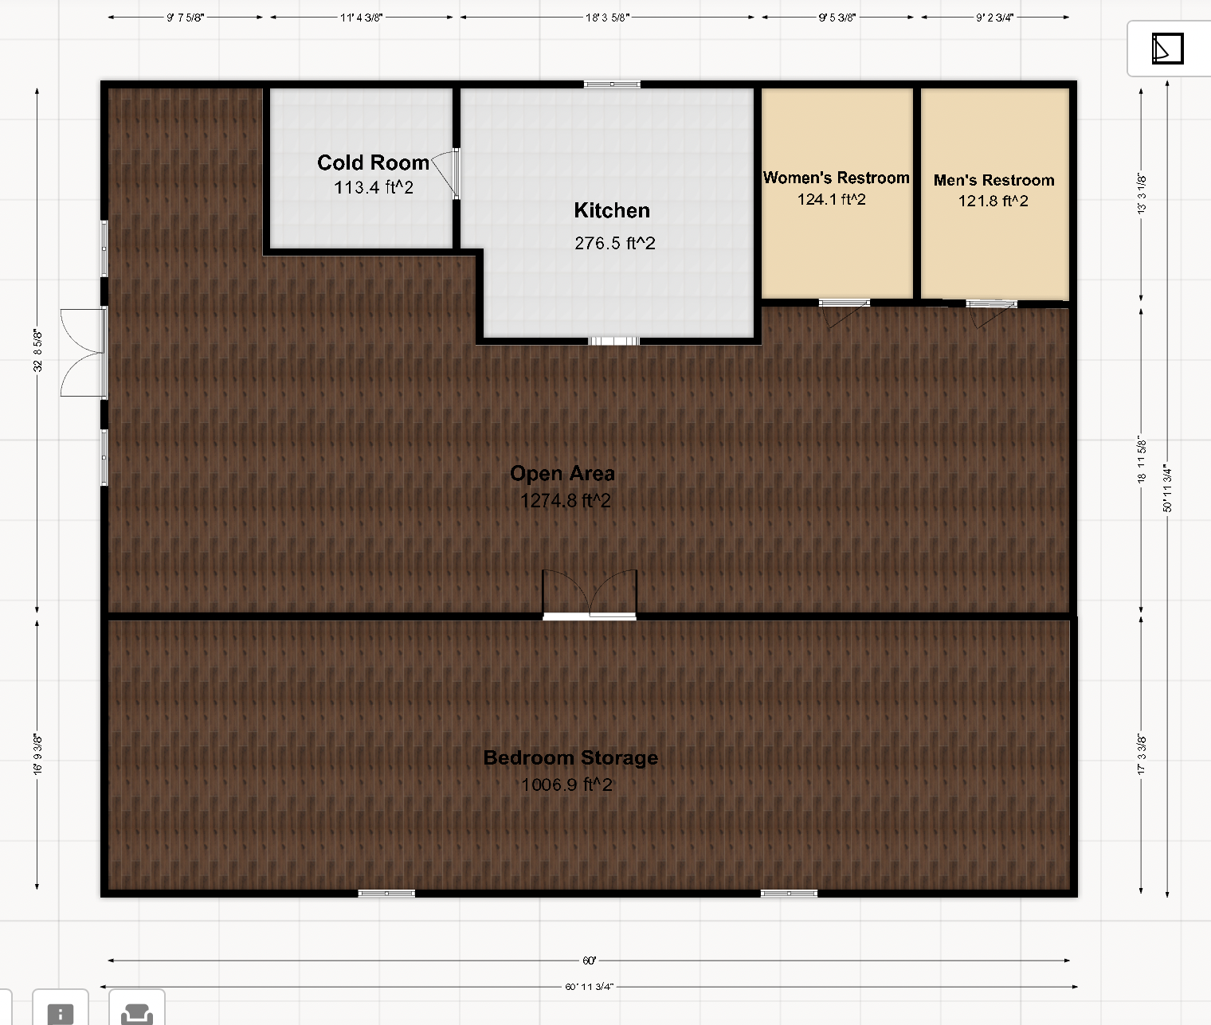
2.2 Architecture Design (Floor Plan)
Bedroom storage room would contain all of the bunkbeds that will be used whenever there’s a natural disaster
Open area section you would mainly have the space open and free to roam so that the people in the shelter are able to communicate with others
Cold room store all of the cold meats that needed to be stored
Kitchen would be where the cooking will be done as well as where the people could serve themselves their own food
Both bathrooms are to be separated so that in case of an emergency it doesn't get occupied as easily

Slide 10
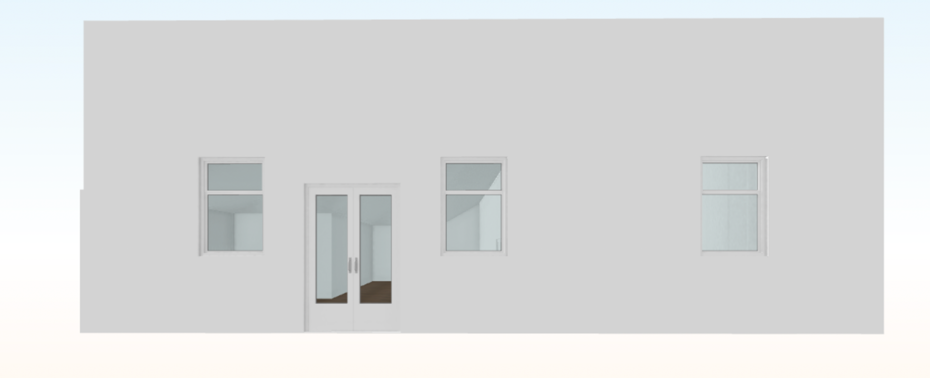
2.2 Architecture Design (Front Elevation)
Contains Double Hung Doors and Three Double Hung Windows that are hurricane impact proof
The material that the Double Hung doors and windows will be out of laminated glass
The laminated glass contains an interlayer that holds the glass together even though it it shattered already.
Notes:
https://www.pella.com/performance/impact-resistance/how-to-choose-hurricane-impact-doors/

Slide 11
2.3 Quality Assurance Plan
JORSH construction Inc will :
Have several tests conducted on the concrete and steel before construction.
The result of the test would be included in the weekly and monthly meetings
Daily reports would be submitted to show the progress of the construction process
The shelter is going to build in accordance with the requirements in chapter 16, 18 and 22 of the 2015 Louisiana Building codes

Slide 12
3. Expected Project Results
We expect to build an emergency shelter with a structure that is strong enough to resist strong winds and floods or hurricanes.
We expect to save more people’s lives with a local shelter in a timely manner, affected by natural disasters.
We expect to help the government to provide a good service and a comfortable place for those people who need to evacuate their houses and might need to stay for longer. Facilitating the organization and providing more efficient services, such as food, water, and first aid.

Slide 13
3.1 Measure of Success
The concrete will be evaluated according to the American Concrete Institute(ACI) requirements to determine its quality. The test would be used to determine the following properties of the concrete used :
Temperature
Density
Strength of the concrete
Once the concrete passes all the requirements, then it would be used.
The steel that would be used will be tested for its compression and tensile strength against extreme weather like hurricanes

Slide 14
3.2 Budget
Land Acquisition/ Construction | Acquisition of the land where the shelter will be constructed. Construction materials such as bricks, concrete, steel, etc… | $ 1,800,000
Project management & Design | Architect, engineers, project manager, and other professional services. The salary base is $60K/year. | $ 1,080,000
Construction Worker | Construction inspector, Capeners, brick mason, painter, Roofer … The salary base is $35k/ year. (14 workers) | $ 980,000
Furniture | Includes bunk beds, and the kitchen furniture/equipaments. | $ 75,000
Sub-Total |  | $ 3,935,000

Slide 15
4. Schedule
Date | Task
May - August, 2022 | Meet with the mayor of New Orleans, Latoya Cantrell, St. Bernard Parish President Guy McInnis, and Homeland security emergency preparedness, John Rahaim to discuss the project and develop the Project Management Plan.
August - January 2023 | Finalize project building plans. Secure architect for building design specifications. Develop shelter operations policies. Create an operating budget and funding sustainability plan.
January 2023 - February 2025 | Begin construction work, staff recruitment, and review operations plan.
March, 2025 | Revision and approval of the mayor of New Orleans, Latoya Cantrell, St. Bernard Parish President, Guy McInnis, and Homeland security emergency preparedness, John Rahaim of the shelter.
April - May, 2025 | OPEN FACILITY

Slide 16
Reference
rthompson@theadvocate.com, R. I. C. H. A. R. D. T. H. O. M. P. S. O. N. |. (2015, August 23).
St. Bernard Parish rebuilds itself from utter devastation after Hurricane Katrina. The Advocate. Retrieved May 1, 2022, from https://www.theadvocate.com/baton_rouge/news/article_8b548335-05ab-51c0-aa88-4ba5400a1c58.html#:~:text=.-,Hurricane%20Katrina%20left%20St.%20Bernard%20Parish%20a%20ruin.,story%20homes%20off%20their%20foundations
SAMHSA. (2022, April 22). Homelessness Resources: Housing and Shelter. SAMHSA.
Retrieved May 1, 2022, from
https://www.samhsa.gov/homelessness-programs-resources/hpr-resources/housing-shelter#:~:text=Transitional%20or%20supportive%20housing%20and,commonly%20recognized%20causes%20of%20homelessness
N.d. Emergency shelter project - Ozaukee Country. Retrieved from https://www.familypromiseoz.org/wp-content/uploads/2021/08/Emergency-Shelter-Project-OZ-Case-Statement.pdf

